Slide 1


Sharks and Fishes Serial Program
Programmed and Presented by:
Michael Dillon,
Dahir Mussa,
Thomas Fokas,
Shannon Dunne

Slide 2

Sharks and Fishes The Rules

Slide 3
‘Ocean’ Starting Rules
Roughly 60% fish, 15% of this being baby fish.
Roughly 20% sharks, 15% of this being baby sharks.
Finally, Roughly 20% is empty.

Slide 4
The Rules We Have Set (Shark)
Sharks are represented by the numbers 11 – 30.
They can breed from 13 – 30.
They have a 3 percent chance of death per generation.
If they have no fish neighbours, they have a 50 percent chance of death.

Slide 5
The Rules We Have Set (Fish)
Sharks are represented by the numbers 1 – 10.
They can breed from 3 – 10.
12.5 percent chance of death per shark neighbor, 8 shark neighbors means certain death
If 4 or more fish neighbours, they have a chance of death also, due to overcrowding.

Slide 6

Program Files

Slide 7
New Ocean
Void newOcean()
{
for(int i = 0; i < n; i++)
{
for(int j = 0; j < n; j++)
{
float rand_number = ( (float) rand() ) / RAND_MAX;
if(rand_number >= x)
{
Cells[i][j] = (a certain state)
}
else if(((rand_number < x) && ((rand_number >= y))
{
Cells[i][j] = (a different certain state)
}
}
}
}

Slide 8
Check Neighbors
void checkNeighbours()
{
// Northwest Neighbor
if(Cells[i-1][j-1] == fish)
{
// Increase the number of shark neighbors by 1
fishNeighbor += 1;
}
else if(Cells[i-1][j-1] == shark)
{
// Increase the number of shark neighbors by 1
sharkNeighbor += 1;
}
//Checked for each direction.
}

Slide 9
Check State (Breeding)
if(Cells[i][j] == breed-able) // In this case [i][j] is a fish
{
if((Cells[i-1][j-1] ) && (Cells[i-1][j] == 0))
{
Cells[i-1][j] = 1; // Baby fish is born!
}
}

Slide 10
Check State (Death)
// This is an example of fish deaths
if( (sharkNeighbor == 1) && (rand_number <= 0.125) )
{
Cells[i][j] = 31;
}
else if((sharkNeighbor == 2) && (rand_number <= 0.25))
{
Cells[i][j] = 31;
}

Slide 11
Sharks and Fishes Main Program
for(a = 1; a <= numberofgenerations; a++)
{
printf("Gen: %d\n", a);
for(i = 0; i < n; i++)
{
for(j = 0; j < n; j++)
{
// INCREMENT CELL TYPE
}
}
}

Slide 12

The Output

Slide 13
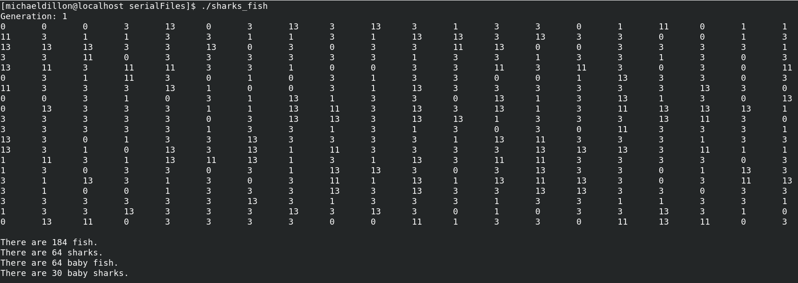
Running The Program (Generation 1)
0 – Empty 3 - Adult Fish 13 – Adult Shark
1 – Baby Fish 11 – Baby Shark

Slide 14
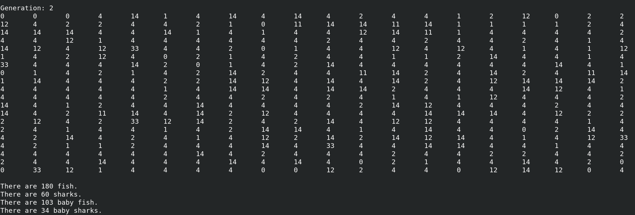
Running The Program (Generation 2)

